Slide 1
Your team proposal title
Your team name
Rename your ppt as your team name and upload into LumiNUS.

Slide 2
Team members
List your team members’ name (as in your course registration)

Slide 3

Your chosen dataset
Choose 1 dataset based on your interest
https://archive.ics.uci.edu/ml/index.php

Slide 4
Business objective
For example, perform machine health monitoring, perform human activity monitoring, etc.

Slide 5
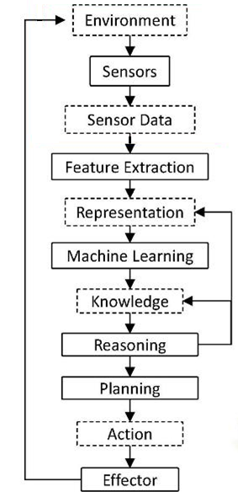
Intelligent sensing system pipeline
Pipeline 1
Use the suggested system pipeline to design your solution
Choose only one pipeline (you might want to skip certain module)
Pipeline 2

Slide 6
Any other additional comment
Technical limitations, etc

